Slide 1
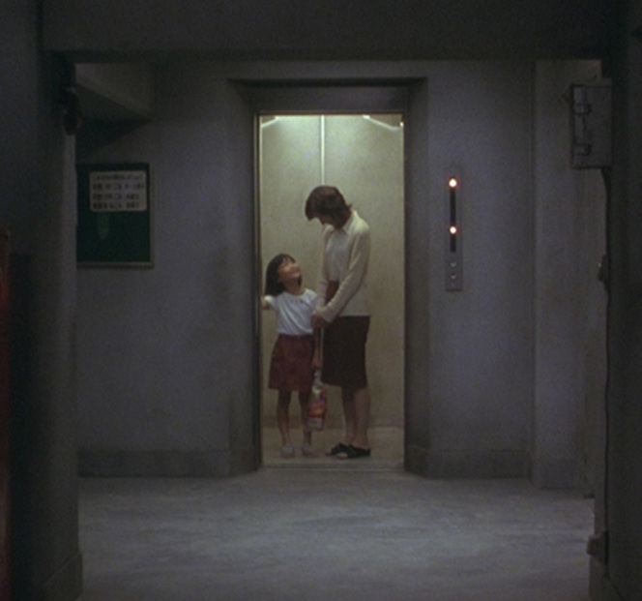
SM5306 · PREPRODUCTION PROPOSAL
裕寿大厦
JYU SAU
BUILDING
失忆的阿汤潜入大厦窃取资料，
却发现秘密实验指向自己遗忘的过去。
An amnesiac steals corporate files, only to uncover a secret experiment tied to his forgotten past.
AI悬疑恐怖短片 / AI suspense–horror short
视觉参考 / Dark Water · Film Forum
Notes:
中文 · 约 35 秒
大家好，我们这次带来的项目是《裕寿大厦》，一部计划通过AI制作的悬疑恐怖短片。
故事围绕失忆的阿汤展开。他为了偿还债务，进入裕寿大厦窃取一家公司的旧资料，却在调查离奇死亡和秘密实验的过程中，发现所有线索都在指向自己遗忘的过去。
目前，我们已经有了一版完整的剧情和阿汤的人物小传。接下来会重点调整人物对白、前期的压抑氛围，以及高潮反转的呈现。这次提案主要介绍故事、预期的视听方向和制作安排。
ENGLISH
Hello everyone. Our project is Jyu Sau Building, an AI-produced suspense–horror short film.
Ah Tong has lost his memory. To repay his debts, he enters an old commercial building to steal corporate files. As he investigates unexplained deaths and a secret experiment, the evidence starts pointing to his own forgotten past.
We currently have a complete story draft and a character biography for Ah Tong. Our next revision focuses on distinct character voices, a more restrained opening, and a stronger presentation of the central reveal. Today we will introduce the story, the intended audiovisual approach, and our production plan.
SOURCES / 图片与事实来源
All film imagery is reference material, not finished footage for Jyu Sau Building.
https://filmforum.org/film/dark-water-japanese-horror

Slide 2
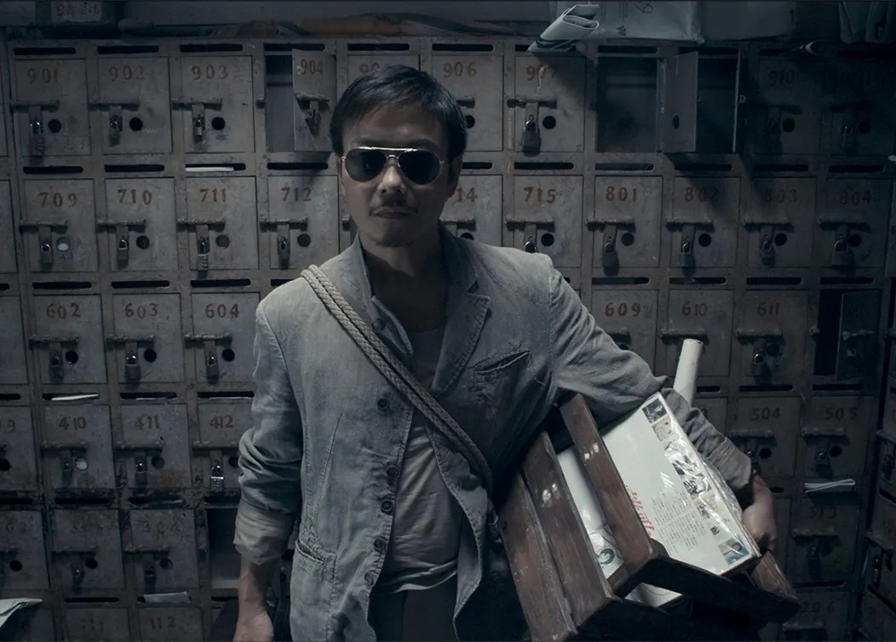
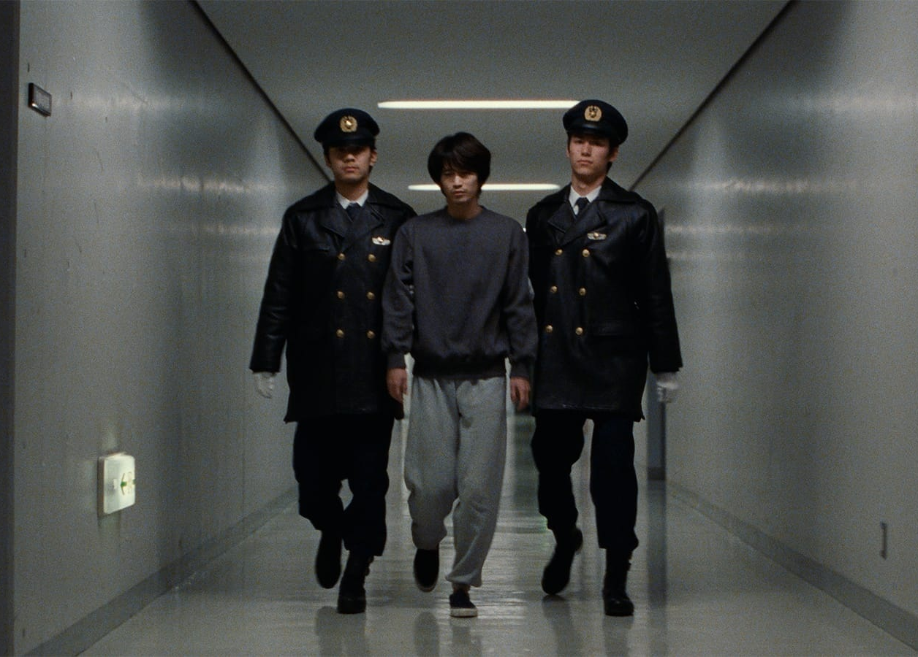
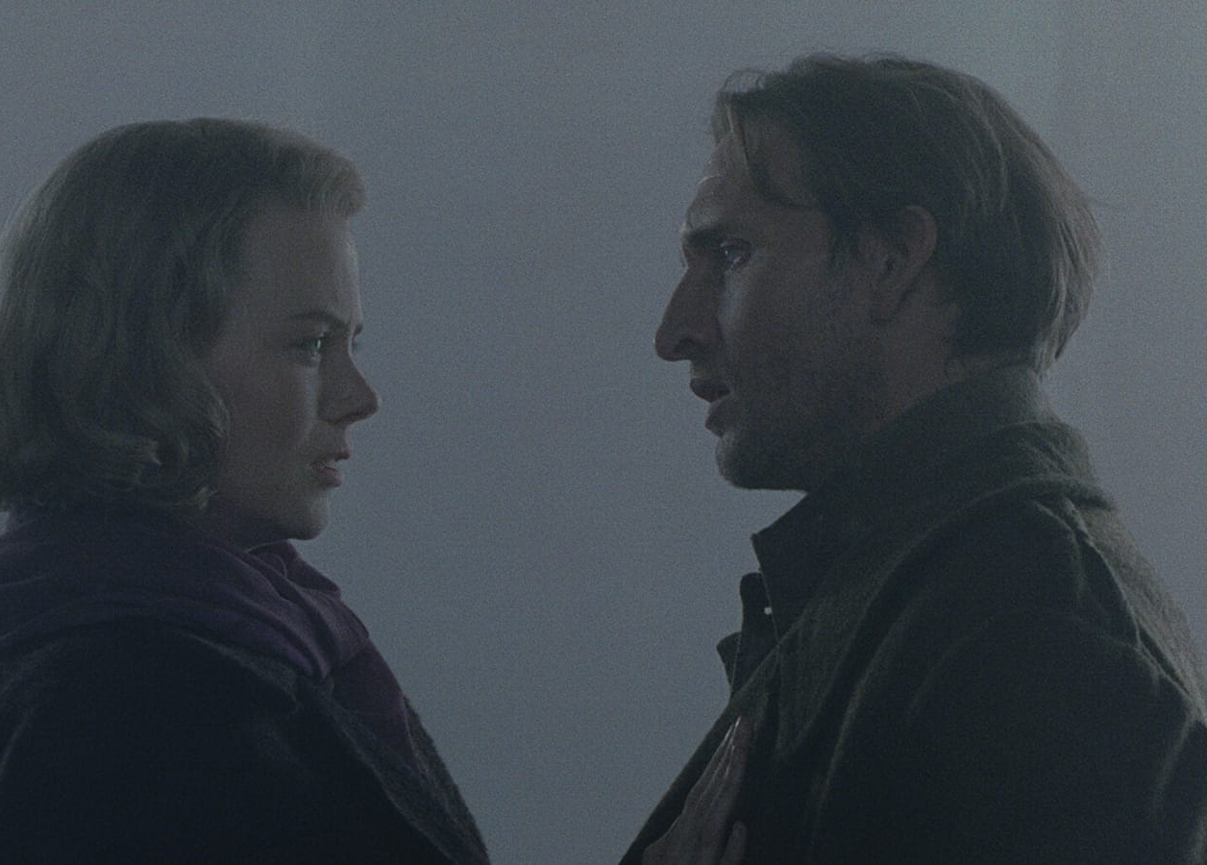
一次潜入，走回自己的过去
A break-in becomes a return to a forgotten past
01 潜入 · 窃取资料
02 调查 · 发现自己
03 重逢 · 相信或拒绝
Debt → a night job → stolen files
Room 3016 → deaths → experiments
His dead sister → trust or escape
现稿：两个结局中，保健药仍会重新进入市场。结局衔接继续优化。
Current draft: the medicine returns to market in either ending. The transition is still being refined.
裕寿大厦 / JYU SAU BUILDING
Rigor Mortis · Cure · The Others / reference stills
02
Notes:
中文 · 约 100 秒
故事发生在一栋旧式商业大厦里。
阿汤受到债务催收的威胁，接受抽烟男的委托，利用夜班工作进入裕寿大厦，复制“美丽新世界”公司的机密资料。
进入大厦后，负责交接的员工提醒他，不要理会3016室传来的敲门声。随后，阿汤在门外发现公司的旧保健药，也听见有人轻轻叫他“哥哥”。
调查继续推进，他发现服用这种保健药的人曾出现无法解释的死亡。例如，一名老人明明身处炎热天气、家中还开着暖气，却死于严重低温症。与此同时，3016过去住着的一名降头师，也离奇死在自己的房间里。
阿汤追查线索，意外进入废弃实验层。在旧录像中，他看见年轻的自己，也看见正在接受实验治疗的妹妹。他逐渐意识到，自己曾是这个项目的负责人。
随后，已经死去的妹妹出现在他面前，带他进入大厦深处。停用的设备重新启动，一个与他有关的回收程序开始运作。
目前剧本保留了两个结局方向：相信妹妹，最终死亡；或者拒绝妹妹，逃离大厦。但两个结局里，保健药都会重新进入市场，危险仍然存在。
具体的结局衔接和呈现方式，还会在下一轮剧本调整中统一。
ENGLISH
The story takes place in an old commercial building that is still partly in use.
Under pressure from debt collectors, Ah Tong accepts a job from a man who smokes. He uses a night shift at Jyu Sau Building to copy confidential files from a company called Brave New World.
During the handover, an employee warns him to ignore knocking from Room 3016. Outside the room, Ah Tong finds old health supplements made by the company. He also hears someone quietly calling him “Brother.”
As he investigates, he discovers unexplained deaths among people who took the medicine. One elderly man died of severe hypothermia during hot weather, even though the heating was on. A sorcerer who once lived in Room 3016 also died mysteriously.
The clues take Ah Tong to an abandoned experimental floor. In an old recording, he sees his younger self and his sister undergoing treatment. He realizes that he once led the project.
His dead sister then appears and leads him deeper into the building. Dormant equipment starts again, along with a recovery program connected to him.
The current draft contains two possible endings: he trusts his sister and dies, or rejects her and escapes. In either case, the medicine returns to the market, so the danger remains. The connection between the reveal and these endings is still being refined.
SOURCES / 图片与事实来源
All film imagery is reference material, not finished footage for Jyu Sau Building.
https://wellgousa.com/films/rigor-mortis
https://www.criterion.com/films/27666-cure
https://www.criterion.com/films/33636-the-others

Slide 3
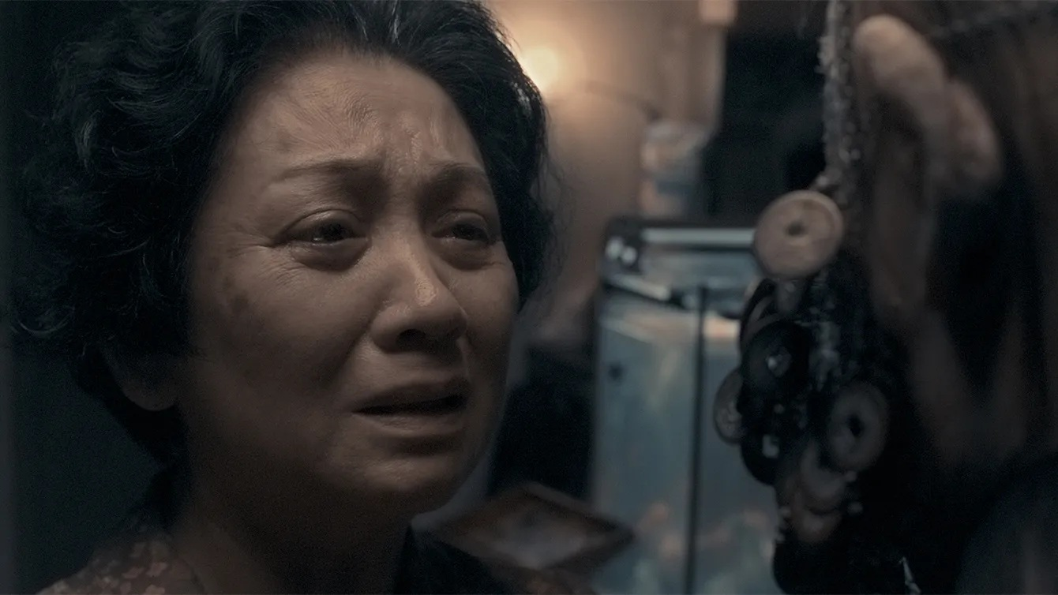
“她需要我”——阿汤的情感核心
“She needs me” — Ah Tong’s emotional core
阿汤：玩笑挡住压力
Ah Tong: jokes under pressure; serious about his sister
妹妹：依赖、委屈与挽留
Sister: dependence, hurt and a wish to keep him close
表演与物件关系参考 / Performance reference
NPC：不同信息，不同说话方式
照顾 → 自我价值 → 执念
NPCs: distinct knowledge, motives and speech patterns
Care → self-worth → obsession
人物外形待定 / Character appearance to be developed
继续整理：立场 / 目的 / 对白习惯
In development: stance / intention / voice
裕寿大厦 / JYU SAU BUILDING
Rigor Mortis / Well Go USA · 情绪参考，并非角色定妆
03
Notes:
中文 · 约 80 秒
阿汤是整部影片的情感中心。
在日常生活里，他有些敷衍，会拖延，也会用玩笑应付压力。对于自己的生活，他经常抱着“先过了今天再说”的态度。但一旦涉及妹妹，他就会立刻认真起来。
人物小传补充了这种性格的来源。父母离开之后，他承担了照顾妹妹的责任，也逐渐把“妹妹需要我”当成自己人生价值的重要依据。
因此，他的照顾会慢慢变成一种无法停止的执念。即使妹妹不需要如此强烈的治疗，他仍然认为自己必须继续。
失忆后，他仍然相信妹妹活着，继续保留照顾她的习惯。我们希望通过具体的生活细节，让观众先理解他对妹妹的感情，再逐渐发现其中的问题。
妹妹则承载着兄妹之间的依赖、委屈和挽留。其他NPC掌握的信息不同，也会以不同方式影响阿汤。
目前，我们正在进一步整理所有人的立场、目的和说话习惯，让他们在对白和行为上有清楚的区别。
ENGLISH
Ah Tong is the emotional center of the film.
In everyday life, he procrastinates, avoids responsibility and uses jokes to handle pressure. His attitude is often to get through today first. But when his sister is involved, he becomes serious immediately.
His biography explains this contrast. After their parents were gone, he took responsibility for his sister. Being needed by her gradually became central to his sense of worth.
Care then turns into an obsession he cannot stop. Even when she does not need such aggressive treatment, he believes that he must keep trying.
After losing his memory, he still believes she is alive and keeps his old habits of caring for her. We want everyday details to make the audience understand his affection before they recognize its troubling side.
His sister carries dependence, hurt and the desire to keep him close. The other characters possess different information and influence him in different ways. We are still clarifying everyone’s position, intention and speech patterns, so they can be distinguished through dialogue and behavior. The images here are performance references, not finalized character designs.
SOURCES / 图片与事实来源
All film imagery is reference material, not finished footage for Jyu Sau Building.
https://wellgousa.com/films/rigor-mortis
https://www.criterion.com/films/27666-cure

Slide 4
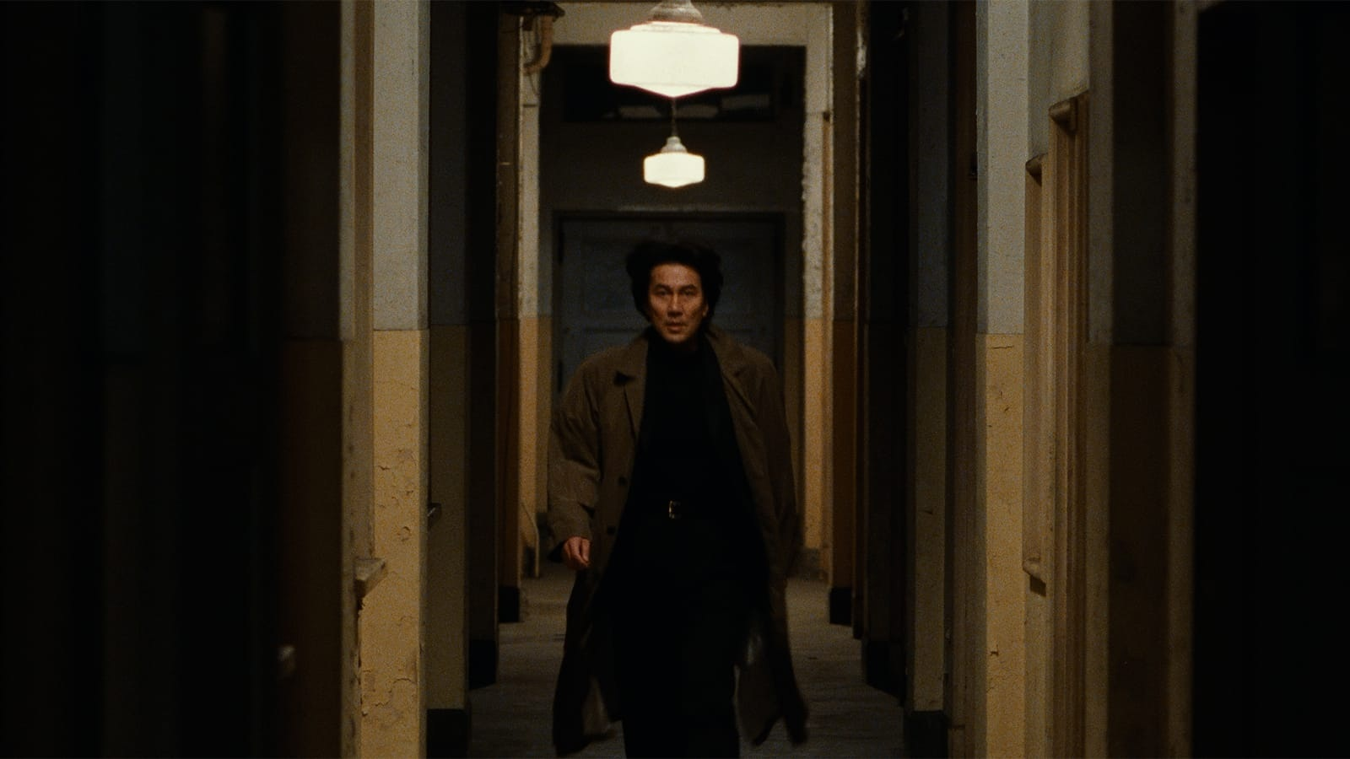
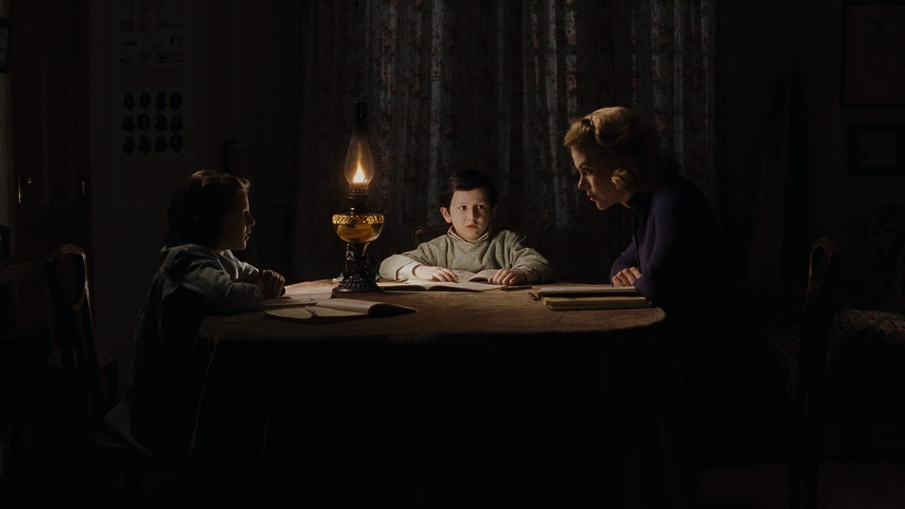
熟悉的空间，轻微的不对劲
Familiar spaces. A quiet sense that something is wrong.
旧楼纵深 · 重复门框
局部照明 · 保留暗处
Worn interiors · receding doorframes
Practical light · unreadable corners
灰绿 / 灰蓝 / 暖钨光 · 让观众有时间看见空处
裕寿大厦 / JYU SAU BUILDING
Cure · The Others / Criterion · 构图、光线与材质参考
04
Notes:
中文 · 约 80 秒
视觉上，我们希望大厦保留一种可信的生活感。
它曾经有人工作，现在还有部分空间继续使用，但旧办公室、走廊和封存区域已经显得疲惫、陈旧。情绪板会围绕这些空间展开，关注荧光灯、旧墙面、纸质档案、药盒，以及实验设备的材质。
前期的画面计划相对克制。构图中会保留一些看不清的区域，例如门缝、转角、走廊尽头和人物身后的空处，让观众有时间观察，也无法完全确认空间里是否安全。
光线会尽量有具体来源，例如顶灯、台灯或局部照明。我们希望利用照明范围的限制，让熟悉的空间出现不确定感。
随着阿汤接近真相，画面的节奏和空间关系会逐渐变化，让后段与前段形成明显差别。
情绪板上的参考图片会分别标明借鉴的内容，例如光线、构图、空间质感或人物状态。具体效果还需要通过后续的AI镜头测试来确认。
ENGLISH
Visually, we want the building to feel like a believable place with a history of ordinary use.
Some rooms are still occupied, while older offices, corridors and sealed areas feel worn and neglected. Our mood board focuses on fluorescent lights, old walls, paper files, medicine packaging and experimental equipment.
Early scenes will use restrained framing. Doorways, corners and empty space behind a character can remain partly unreadable. The audience should have time to look, without becoming certain that the room is safe.
Lighting should have a clear source, such as an overhead fluorescent fixture, a desk lamp or a small practical light. Limited illumination can make a familiar place uncertain without constantly introducing dramatic effects.
As Ah Tong approaches the truth, the rhythm and spatial relationships can change. The references here illustrate framing, light and texture; we are not copying their entire stories or intensity. We will test this approach with generated shots before finalizing it.
SOURCES / 图片与事实来源
All film imagery is reference material, not finished footage for Jyu Sau Building.
https://www.criterion.com/films/27666-cure
https://www.criterion.com/films/33636-the-others

Slide 5
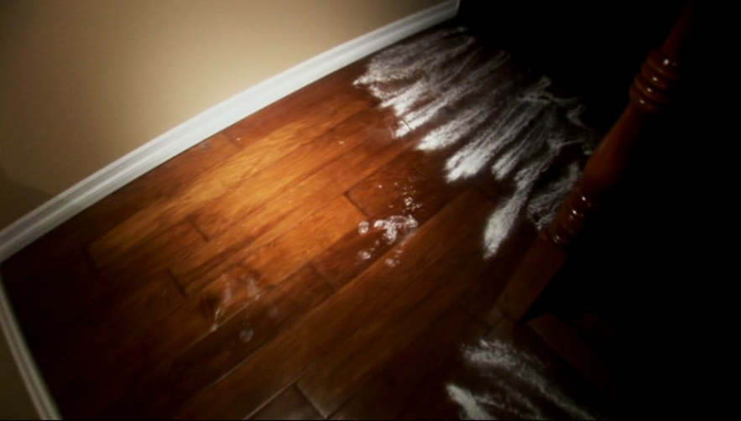
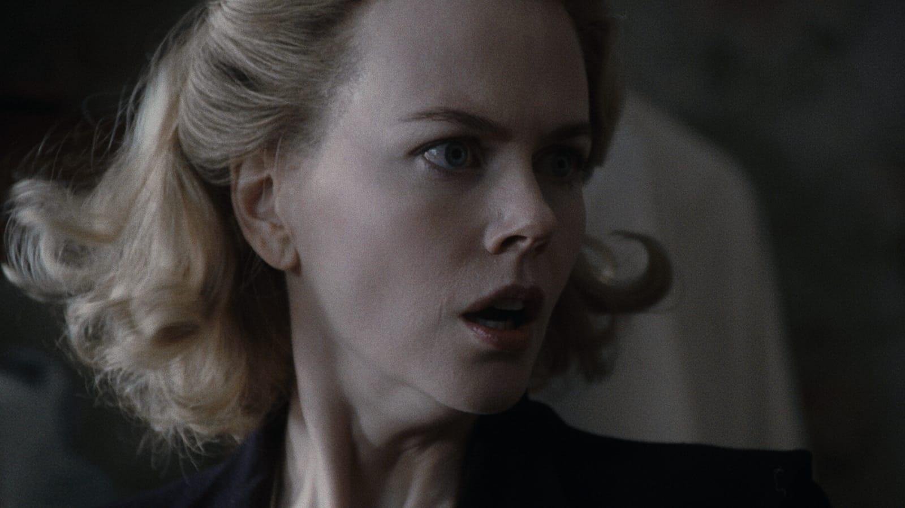
前期：看不见，却能感觉到
Early tension: unseen, but felt
环境留下痕迹
人物先于镜头反应
Traces remain after an unseen presence
A character reacts before the camera explains
现稿：3016敲门与“哥哥” → 优化：降低刺激，拉开异常间隔，保留停顿。
Current: knocking and “Brother.” Direction: fewer shocks, more space between unsettling details.
裕寿大厦 / JYU SAU BUILDING
Paranormal Activity · The Others / 试拍参考，非定稿镜头
05
Notes:
中文 · 约 75 秒
前期主要讲阿汤如何进入大厦，以及他怎样从偷取资料，逐渐转向调查异常事件。
教授的反馈之一是，目前前段已经出现了不少恐怖刺激，容易提前消耗后面的冲击。因此，我们准备重新调整事件的强度和间隔，让前期更压抑，也给观众留下观察的时间。
环境中的异常，以及NPC不自然的反应，会成为这一段的重点。例如，一个人突然停下交谈，看向阿汤看不到东西的位置，随后又若无其事地继续工作。
这些表现需要同时服务于剧情和人物。观众既能感觉到环境不对，也会怀疑眼前的人是否知道更多。
我们也会减少单纯为解释设定而存在的对白。阿汤可以用自己的方式追问，NPC则根据各自的目的回避、敷衍或者引导他。
这一部分正在结合参考片段和人物小传继续优化，具体场景还没有全部确定。
ENGLISH
The opening follows Ah Tong entering the building. His task gradually shifts from stealing files to investigating abnormal events.
The professor pointed out that too many early horror stimuli could reduce the impact of the climax. We therefore want to lower the intensity and leave more time between unusual events. The pressure should build quietly.
The existing story includes knocking from Room 3016 and the voice calling him “Brother.” Our revision will concentrate on how these events are staged, how long we hold on them, and how other people react.
A trace left in the environment can suggest a presence without showing it. A character might also pause and look at an empty part of the room before continuing an ordinary conversation. These are directions for testing rather than finalized shots.
Dialogue should serve the characters as well. Ah Tong can question events in his own casual style, while each NPC avoids, dismisses or redirects him for a different reason. We are developing these choices alongside the character biographies.
SOURCES / 图片与事实来源
All film imagery is reference material, not finished footage for Jyu Sau Building.
https://www.criterion.com/films/33636-the-others
https://bloody-disgusting.com/editorials/3689339/10-scariest-scenes-paranormal-activity-franchise/

Slide 6
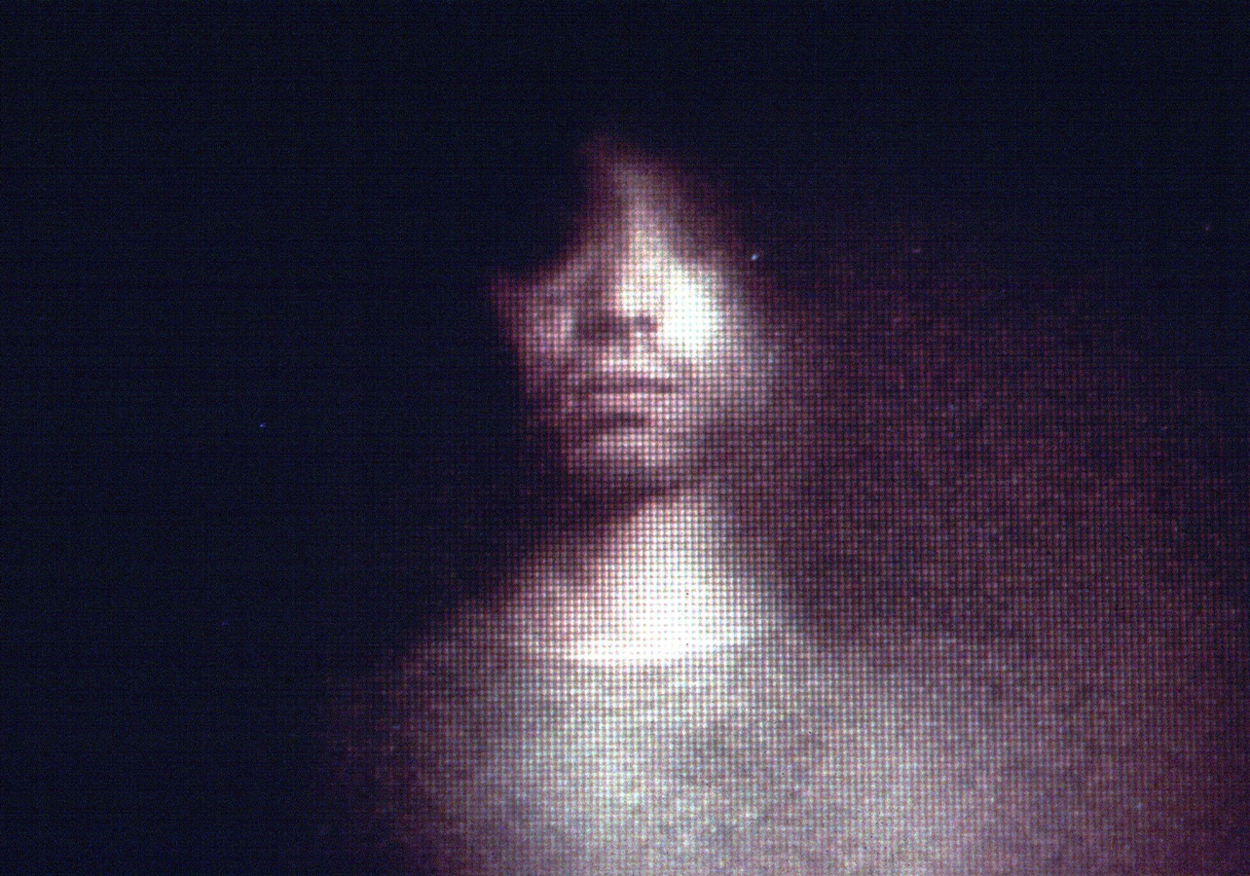
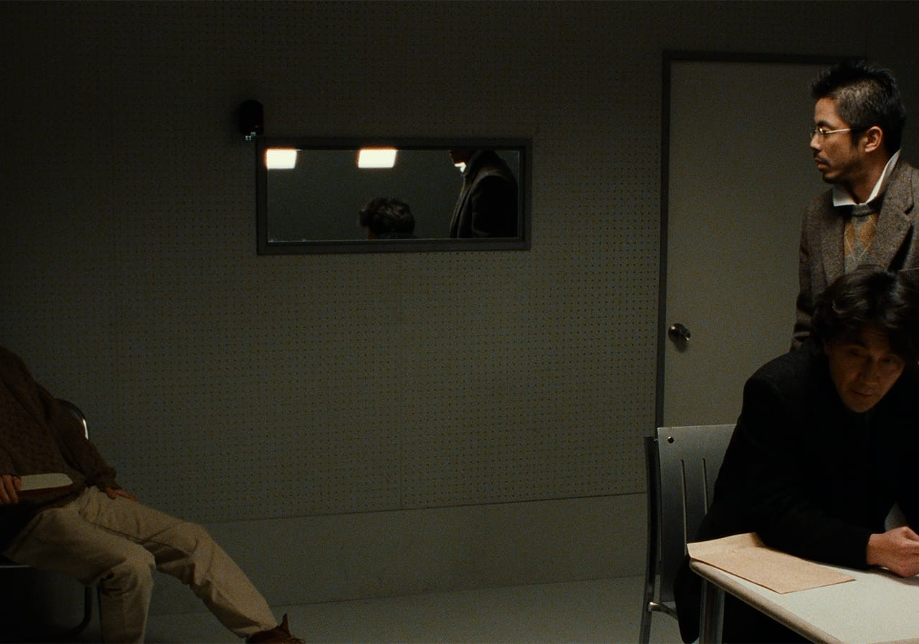
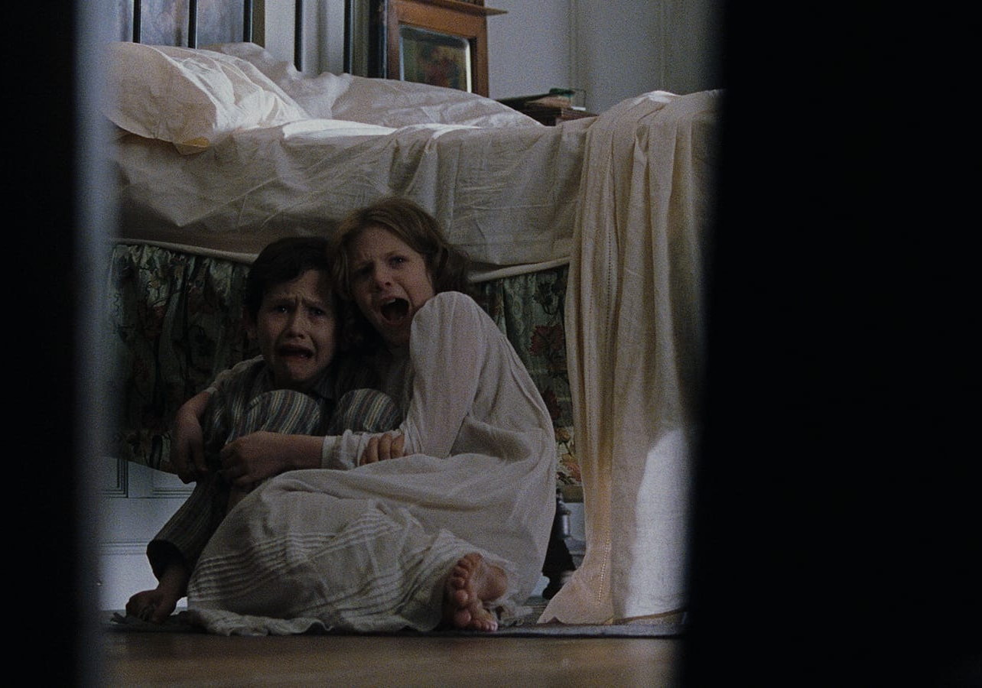
后期：真相必须改变他的行动
The reveal must change what Ah Tong does
发现：录像中的自己
重认：调查者曾是负责人
选择：面对妹妹的挽留
Discovery: himself in the old recording
Reversal: the investigator once led it
Choice: respond to his sister’s plea
优化方向：证据集中 → 当场冲突 → 行动与代价
Direction in development: focused evidence → immediate conflict → a consequential choice
裕寿大厦 / JYU SAU BUILDING
Pulse · Cure · The Others / 场面与表演参考
06
Notes:
中文 · 约 90 秒
后期的核心，是阿汤发现自己曾参与实验，并重新面对妹妹。
目前版本已经有身份反转，但真相主要通过档案、录像和对话逐步说明。我们希望调整这些信息的安排，让关键发现更集中，也更直接地影响阿汤接下来的行动。
这一轮优化会重点检查三个问题。
首先，在揭晓之前，阿汤和观众究竟相信什么。我们需要建立一个明确的判断，后面的证据才能真正改变大家对故事的理解。
其次，真相出现之后，人物之间会发生什么冲突。阿汤不能只是继续听解释，他需要面对眼前的人，尝试离开、拒绝或者采取其他行动。
最后，结尾的选择需要与人物动机联系起来。对阿汤来说，妹妹既是他最在乎的人，也是最容易影响他判断的人。我们希望让观众理解，他为什么愿意相信她，又为什么可能不得不拒绝她。
高潮的具体表现仍在比较和调整中。我们会把参考影片中的揭晓方法，与自己的场景和人物关系结合，再确认最终方案。
ENGLISH
The climax centers on Ah Tong discovering his involvement in the experiment and confronting his sister again.
The current draft already contains an identity reversal. However, much of the truth is explained through files, recordings and dialogue. We want the key discovery to become more concentrated and to change his actions immediately.
There are three questions we are checking. First, what do Ah Tong and the audience believe before the reveal? The initial assumption needs to be clear enough for later evidence to overturn it.
Second, what conflict follows the discovery? He should do more than listen to an explanation. He needs to confront someone, attempt to leave, refuse a demand or make another consequential move.
Third, how does the final choice connect to his emotional needs? His sister is both the person he cares about most and the person who can most strongly affect his judgment. The audience should understand why he wants to believe her and why he may have to reject her.
The exact staging is still under revision. We want the impact to come from recognition, conflict and a difficult choice, while keeping the film’s overall treatment restrained.
SOURCES / 图片与事实来源
All film imagery is reference material, not finished footage for Jyu Sau Building.
https://nwfilmforum.org/films/pulse/
https://www.criterion.com/films/27666-cure
https://www.criterion.com/films/33636-the-others

Slide 7
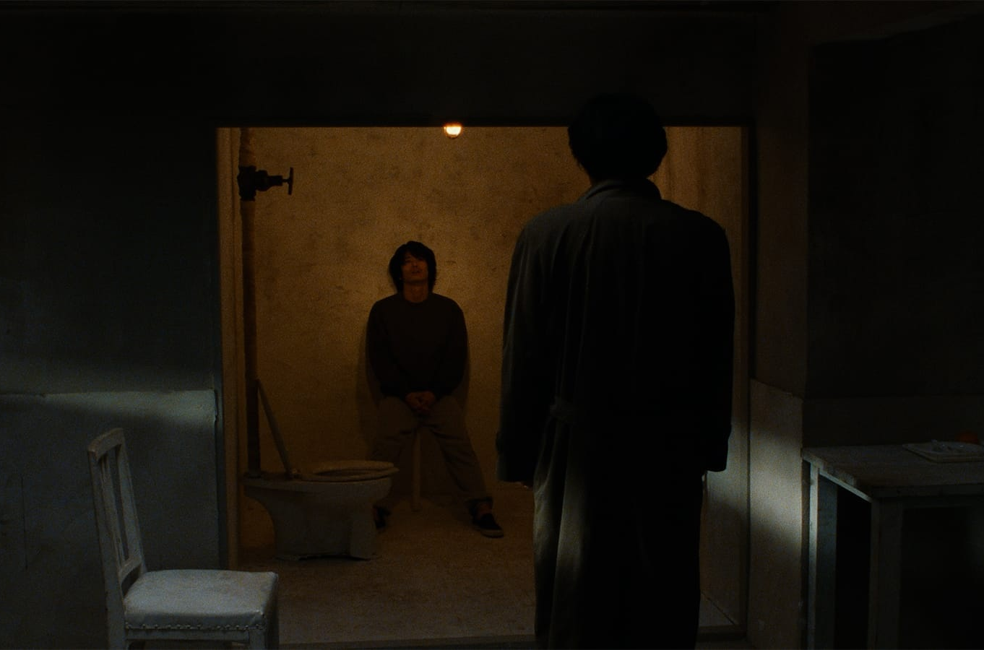
声音：让片段听起来属于同一栋楼
Sound: separate clips, one continuous place
示意 / Illustrative edit — not a finished mix
镜头 A / Shot A
镜头 B / Shot B
镜头 C / Shot C
环境底声
Ambience
对白 / 细节
Voice / detail
淡淡的不安
Quiet, sustained unease
配乐
Music
原生音频 → 按需分轨 → 剪辑混音
底声跨镜头延续 · 音量与空间感统一 · 音效留间隔
Native audio → stem separation
→ edit and mix
Bridge room tone · match level and space · leave breathing room
裕寿大厦 / JYU SAU BUILDING
Cure / Criterion · 配乐轻进入、轻退出 / Gentle fades
07
Notes:
中文 · 约 75 秒
声音上，我们希望保持轻微、持续的不安，不采用跳脸或突然加大音量的惊吓。
目前已有AI视频工具能把画面与音频一起生成，我们计划主要以这种带声音的片段为基础。AI也可以辅助拆分人声、音乐等音轨，但分离后的质量还需要逐段检查。
所以，我们的重点会更多放在剪辑和混音：统一不同片段的底噪、空间感和音量，让它们听起来发生在同一栋大厦里。需要的时候，可以让下一场的声音提前进入，或者让上一镜的声音延续到下一镜，减少拼接感。
图中是剪辑示意。环境底声跨镜头保持连贯，对白、脚步和远处门声分清主次、留出间隔，不把所有声音同时堆满。BGM轻进入、轻退出，保留安静和空间本身的声音。
高潮可以加强情绪和声音的指向，但整体仍然克制。我们会在连续剪辑里检查声音的衔接、密度与停顿。
ENGLISH
For sound, we want a mild but sustained sense of unease, without jump scares or sudden loud stingers.
Some current AI video tools can generate picture and sound together. We expect to use these clips as a starting point. AI tools can also help separate components such as voice and music, although the quality of each separation needs checking.
Our main work will therefore be in editing and mixing. Clips generated separately need to sound as though they belong to the same building. We will match background noise, room character and levels, and let a sound begin before a cut or continue across it when appropriate.
The diagram is an illustrative plan. A continuous ambience layer connects the shots. Dialogue and small details, such as footsteps or a distant door, are spaced apart rather than stacked constantly. Music enters gently, supports selected moments and fades away to leave room for the location itself.
Even at the climax, greater emotional focus does not have to mean a wall of sound. We will test continuity, density and silence in assembled sequences.
SOURCES / 图片与事实来源
All film imagery is reference material, not finished footage for Jyu Sau Building.
https://deepmind.google/models/veo/
https://www.lalal.ai/stem-splitter/
https://www.criterion.com/films/27666-cure

Slide 8
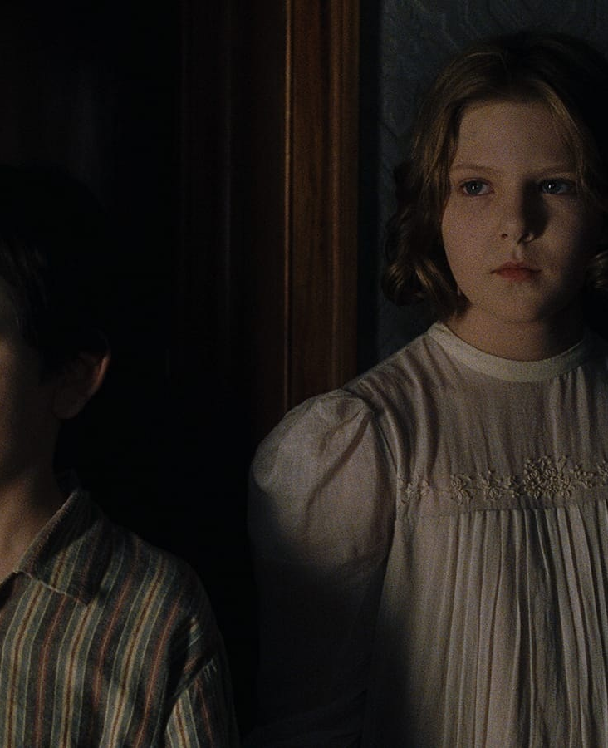
制作计划：每周把镜头放回影片里
Production: build the film through weekly assembled cuts
10.09
故事与呈现方式确定
Lock story, character motives and presentation
10.16
全部分镜头确定
Lock all storyboards, actions and sound needs
11.20
每周生成、剪辑、检查
Weekly generation, editing and continuity checks
左右 / approx.
此后根据反馈，微调镜头衔接、声音与细节。
Then refine transitions, sound and details in response to feedback.
裕寿大厦 / JYU SAU BUILDING
The Others / Criterion · 制作时间为当前规划 / Draft schedule
08
Notes:
中文 · 约 65 秒
制作上，我们计划分阶段推进。
第一阶段到10月9日，确定全部具体故事情节和呈现方式。这一阶段需要统一人物动机、关键对白、高潮和结局，并明确前期需要埋下哪些线索。
第二阶段到10月16日，确定全部分镜头。每个镜头都会进一步明确画面内容、人物动作，以及对应的声音需求，为后续AI生成提供依据。
10月16日之后，到11月20日左右，我们会每周持续推进影片制作，逐步完成镜头生成、剪辑和声音处理。
因为这是AI影片，人物外观、服装、场景和道具在不同镜头之间的一致性，会是制作检查的重点。对于关键表演和复杂镜头，我们也会预留测试与调整的时间。
每周会把已经完成的镜头放进同一版剪辑里观看，检查情节是否清楚、节奏是否合适，再决定下一轮需要补充或者修改的内容。
11月20日左右是目前规划的制作推进节点。后续会根据老师和同学的反馈，继续微调镜头衔接、声音和其他细节。
以上就是我们目前的项目提案，谢谢大家。
ENGLISH
Our production plan has three stages.
By October 9, we plan to settle all story events and their presentation, including character motives, key dialogue, the climax, the endings and the clues planted earlier.
By October 16, we plan to lock all storyboards. Each shot should specify its visual content, character action and sound needs, so it can guide generation and editing.
From then until around November 20, we will keep producing the film each week: generate shots, assemble them, work on sound and review the result.
Because this is an AI film, we need to check continuity in faces, costumes, locations and props. We will also leave time for difficult performances and shots that need several attempts.
Each week’s output will be placed into an assembled cut, so we can judge the story and rhythm in context. Around November 20 is our current production milestone, followed by further refinements to transitions, sound and details based on feedback. Thank you.
SOURCES / 图片与事实来源
All film imagery is reference material, not finished footage for Jyu Sau Building.
https://www.criterion.com/films/33636-the-others

